Slide 1


2nd Devoxx4Kids November 2016 in Wiesbaden
Our lessons learned and best practices for running a conference day on your own
Stefan Höhn
@devoxx4kids @devoxx4kidsde @aoepeople @kruemel42

Slide 2
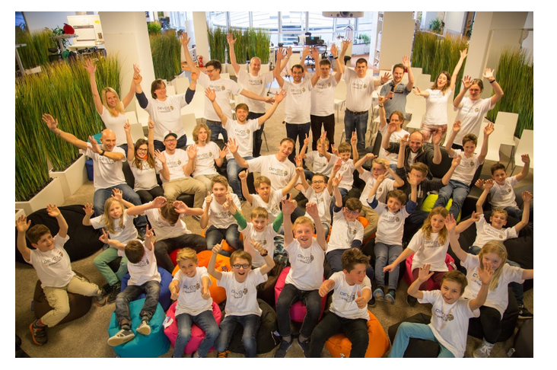
Highlights
30 Kids
10 Parents
25 Mentors and Helpers
Beginners and Advanced Kids
2 new workshops

Slide 3

Disclaimer
Despite everything I am going to say or mention, it is still one of the most fun and passionate thing I have ever done!
And: We try to be perfect ;-)
Not everything needs to be done that way…
And: Others do it differently and works as well nicely

Slide 4
Don´t underestimate Organization – it is a conference!
Being naive helps survival … ☺
Communication
Don’t expect kids and parents to flood the event in the beginning – it takes time to become known
Convince „enough“ kids and parents by talking to them in person
“Word of mouth“ helps a lot in the beginning
Contacting the parents
Mail first response with forms
Receive forms and confirm
Second mail around 4 weeks before event (bcc)
Third mail a few days before event (bcc)
Fourth mail after the event

Slide 5
Schedule
Have the right schedule. It depends on
Number of workshops
Length of Workshops
Breakfast
Opening Session
Lunch
Closing Session
Parents Session
There is an example later on in slides

Slide 6
Choose the right (amount of) Kids
The optimum is if every 2 Kids have a mentor!
You need enough space / rooms
The number of workshops determine the number of workshops
if you add one child it has to be added to a pair and it becomes a group of 3 which is harder to mentor especially for non-experienced mentors.
Assemble the right teams and pairs of kids by
Age
Experience
Siblings (sometimes do or don´t!) and friends
The right age
from (8-)10-14 years old
A difference of 4 (or even 6 years) makes a massive difference
in understanding and creativity
in maturity
in endurance!

Slide 7
Workshop topics
Workshops run in parallel
Choose the “right” workshops
There are more than enough workshops on devoxx4kids / devoxx4kidsde github
…but you want to also do your own... #geek
Each workshop adds another team and time slot
Each kid likes to do all workshops
Alternative: Let them chose upfront (but is even more upfront organisation and can lead to disappointment)
How long should the workshop be?
The all need to be the same length! Otherwise the schedule becomes difficult to be in parallel (see example)
Kids get exhausted after several hours

Slide 8
Workshop topics
Choosing the right workshops
Our primary goal was that the kids could continue at home
Second goal was that the topics were different
Sound: Sonic Pi
Coolness: Minecraft (more about that later)
Robot: mBot
2nd Event:
Sound: Sonic Pi
Robots: mBot and Jumping Sumo
Virtual Reality Cardboards

Slide 9
Workshop topics
The goal of the workshops
Make sure your team has the same vision. This is ours:
Kids should have fun learning something
The goal is not to teach ”programming”
It would be nice if they finish something they can show in the end (to their parents)
… but let them become creative
Be a guide, not a teacher
... but also be clear and strict when they start “freaking” around.

Slide 10
Mentors and the other members of the team
Best would be if every 2 Kids have a mentor (30 Kids → 15 Mentors!)
Mentors can become sick, so you may want extra ones
Mentors like to have the luxury to not do all sessions to with other workshops → add more mentors
You need one organization-person
One dedicated IT-person is a great idea
You may want to have a photographer and video person
You most probably need to have a ”project manager”…
Now do the math and do the sum of all people…

Slide 11
Mentors and the other members of the team
Mentors do not need to be IT-people!
Mentors need to be trained
You should have a workshop lead
Then train the trainers (=mentors)
Don’t do that the evening before
Give the mentors time to prepare and play
Make sure the lead knows the workshop well and knows how to “teach” kids
Mentors who do it the first time usually need to have some support
Do-Pair-Mentoring in the first workshop

Slide 12
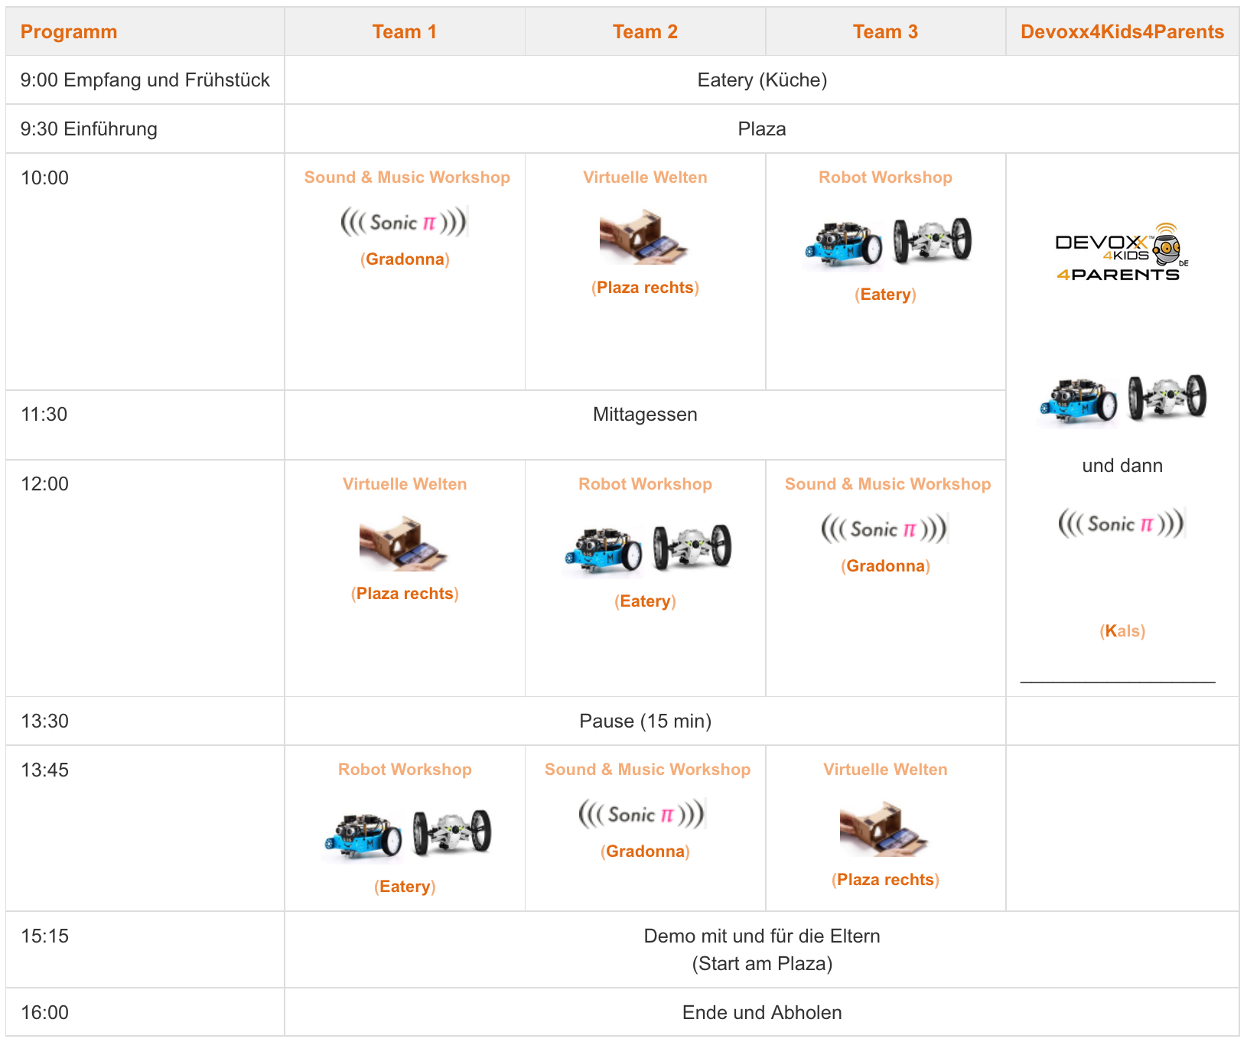
An example schedule
Breakfast
Introduction
Slot 1
Lunch
Slot 2
Break
Slot 3
Outro Parents Demo
Finish

Slide 13
How to deal with different experiences
We have
new kids
and kids that have been with the devoxx4kids before
How to deal with that?
Don’t let them participate? ☺
Let the kids be bored?! ☺
Do other workshops every time…?
Add something else to the mix of workshops
What we did
We developed advanced courses for the “old” courses
We added new workshops, so the kids could chose
However
this adds upfront work
requires the mentors to have knowledge of several workshops
requires a bit more setup per workshop team

Slide 14
Money
We love to give T-Shirts to the Kids
One T-Shirt is around 15 EUR
We even manually iron names on the sleeve (left side!)
Design it and don´t forget the sponsors
Mentors also like a T-Shirt
Equipment for the kids
You need a lot of PC/Notebooks or Raspberry Pis
I do not recommend the kids to bring their own equipment
It adds a lot of uncertainty. If you should provide more IT-people and ask the kids to come earlier
Robots and other toys
You need to have at least 4-5 devices/workshop plus a spare
Hardware can be shared between the D4K teams but this requires more organization upfront
a Sumo Drone or mBot costs 80 EUR, a Lego Mindstorm 350 EUR, a Nao costs 6000-7000 EUR
A gift to take back home

Slide 15
Money
One event can quickly get to a thousand Euro
T-Shirts 30 x 15 Euro
Buying some toys (200-300 Euros) and much more
Breakfast and drinks (100 EUR +)
A gift to take home (Cardboards 100 EUR)
…

Slide 16
Money: Try to ask for
Sponsors
Ask your partners
Even ask your clients
Offer them
Logo on T-Shirts
Mentions on Twitter and Blog-Posts
Mentions in Emails
Ask the @Devoxx4Kids
Ask the parents for donations on the event
AND…

Slide 17
Money: Ask for
an entrance fee!
It does cover some of the costs and relieves you a bit from finding too many sponsors
but the most important thing
It reduces the no-show-rate massively
…as sad as it sounds
if you are not allowed to take money, I would recommend to overbook by ~10%

Slide 18
Formal stuff
Insurance
Make sure you have an insurance for the kids
Formally you need to have the parents sign that the kids can stay with you over the day
Ask about allergies
Let the parents sign that you can take pictures and videos
Make sure you get the forms some time before the event!
You could allow to bring the forms on the day but it creates more work on that date to check everything.
Make sure the parents pay before the event!
Talk to the responsible people of the venue
opening times
security
…

Slide 19
Preparing the venue for the event
Have a plan
which team needs which room
who is preparing which room
Preparation
if possible setup all hardware the day before
make sure everything is running well (test it!)
if you don’t you’ll become nervous very quickly!
Remember: 15 workstations plus all the toys and software is a hell of lot stuff that may not work
Prepare the entrance “booth”
Have a list of all Kids and parent contact information
Make sure you have a waiting list in case kids call in sich

Slide 20
Do an introduction in the morning
Be sure to mention social media and ask for twittering: @devoxx4kids
Explain what the devoxx4kids is
The name is not self-explaining
Tell / Sell the parent the amount of effort that went into the organization
It increases the appreciation for the event a lot
Explain what the intent of the event is
Tell the kids how the event takes place
Tell the kids at the very beginning
that every kid will be in every workshop
about how you grouped the teams
where the workshop rooms are (and toilets and reception)
Let each workshop lead introduce each workshop
At the end read every kid’s name and the team name and point them to their first workshop lead person
Let the workshop lead guide them to the first room
Tell the parents when to be back to see the results

Slide 21

Rules
Kids need rules & help
Follow your mentor
Help your team pal
When I am hungry
When I am thirsty
Don’t run around
Don’t leave the venue!
Whom to ask for help.
…

Slide 22
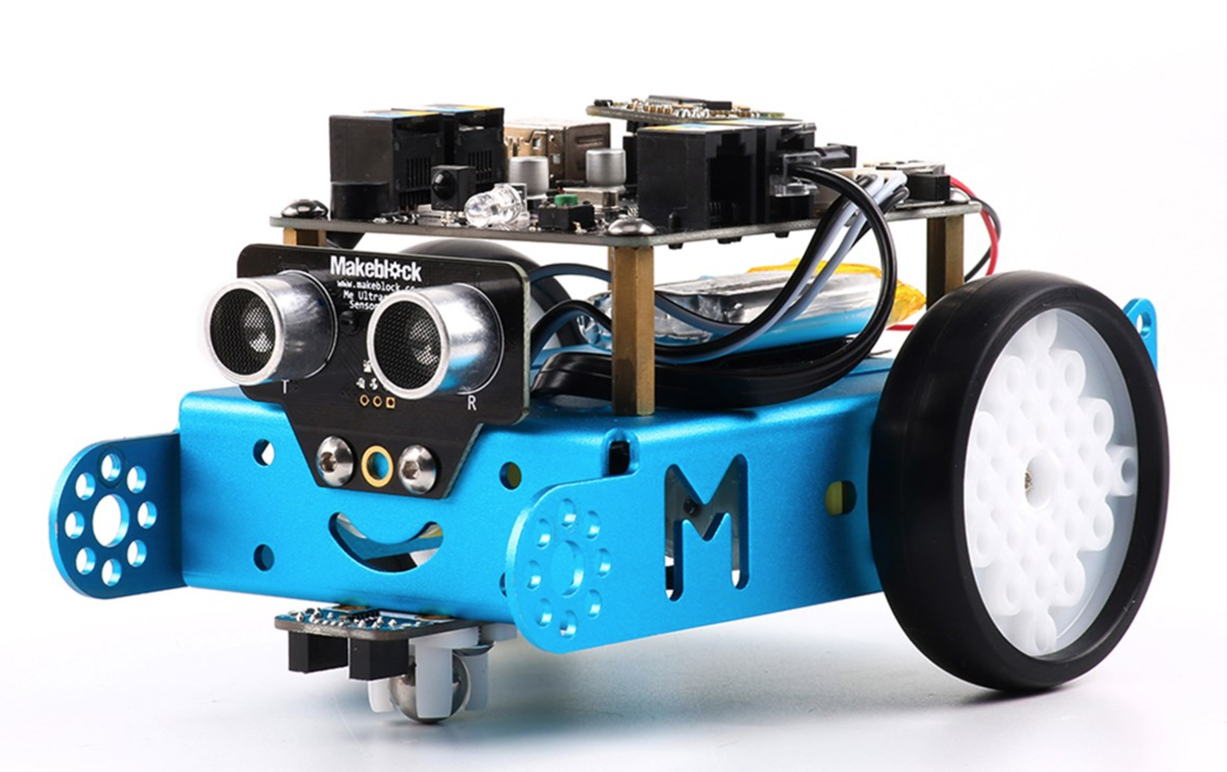


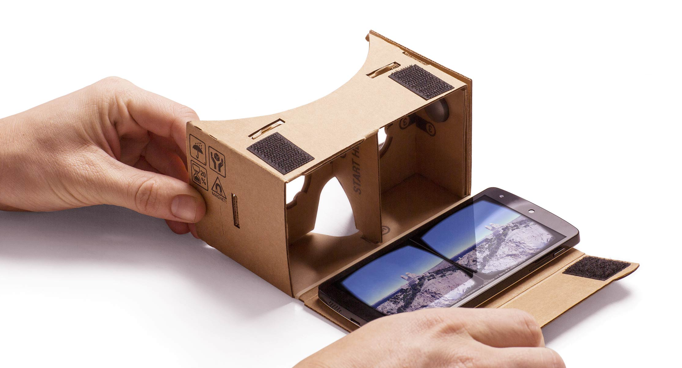

Our Workshops

Slide 23
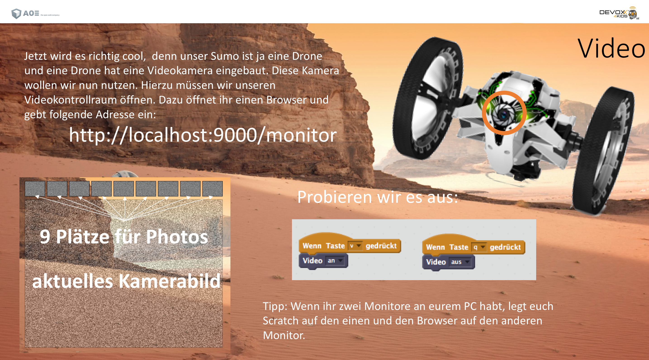
Jumping Sumo on a Mars mission …

Slide 24
Do an outro in the afternoon
Don‘t let them rush out
A nice day should have a nice ending
Make sure you have a group photo taken
Be aware the kids will be tired / exhausted
Enthuse them
Tell the parents about the opportunity to see what the kids have done! #proud
Tell them
about the next event
to spread the word
to register quickly for the next event …
they will get an email with all workshops resources

Slide 25
Something new I tried out …
The intent: the parents can follow up with their kids at home
We taught the parents the same workshops that the kids did
Experience
Takes even more effort to convince the parents but…
the parent who participate were absolutely excited afterwards

Slide 26
Miscellaneous
Tip: create a task board for the preparation time not to forget anything
Form an organization team that helps you – it is just too much work for one person
Meet with your team before they leave the event and say ”thanks”
Devoxx4Kids is not “cool” anymore from a particular age on #puberty
Twitter and Blog and Connect to us as much as you can: @devoxx4kids / @devoxx4kidsde – it is a very nice community.

Slide 27
2.Devoxx4Kids November 2016 in Wiesbaden
Thanks to Katja and Tobsch
at the devoxx4kids in Karlsruhe who helped
to get us going in the beginning and still do…
@devoxx4kids @devoxx4kidsde @aoepeople @kruemel42

